Slide 1
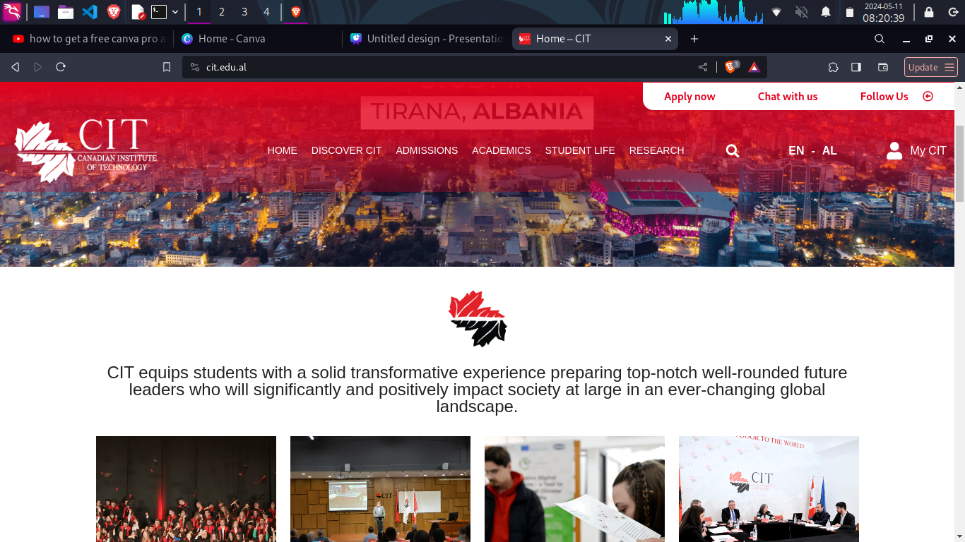
LEARNING
ENHANCMENT

Slide 2
Problem Statement:
Finding the way through the university building was always a hustle (especially for master’s students *wink-wink* ) but not anymore.
Solution Overview:
By providing students with a floor plan that communicates clearly where he should be at any moment in time, confusion goes away.

Slide 3

What are our targets?
Student Support
On-Hand Info
This service enables students to navigate through the college without getting lost.
They have all the information necessary for the lectures in the palm of their hand.

Slide 4




Technologies Used
HTML
CSS
JS

Slide 5
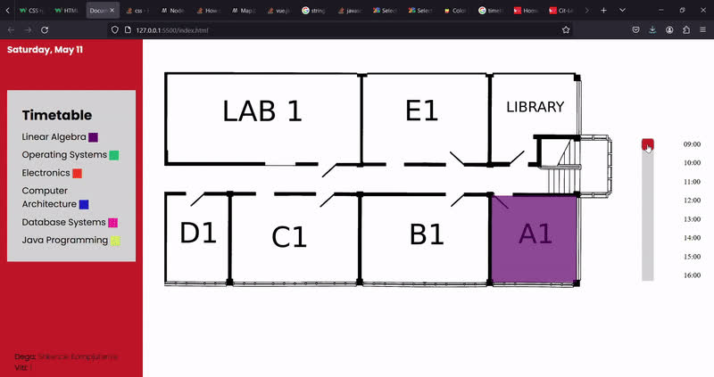
Demo

